Slide 1
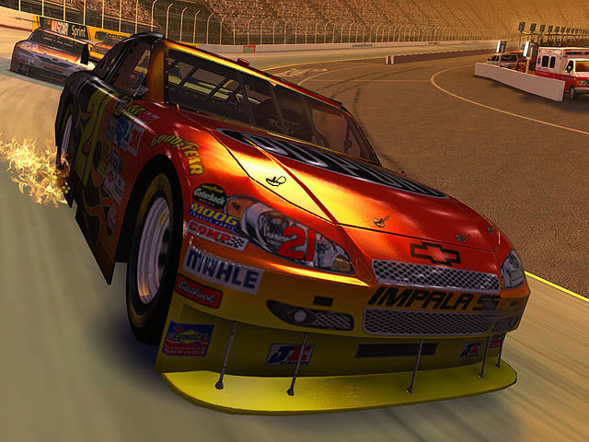
PRO RACER
(The ultimate car racing experience with java)

Slide 2


Guided by: Mr. Abhijeet Bhattacharya
(Asst. Professor ,MSc,M.Tech)
Asabari Mandal -87 [08148001062]
Joydeep Banerjee -51 [08148001071]
Tapomay Sanyal -52 [08148001032]
Namrata Banerjee -07 [08148001056]
Future Inst. of Engg . & Management

Slide 3
Contents Table
Contents Name
1. Project title
2. Project Description
3. Data Flow Diagram
Level 0 DFD
Level 1 DFD
4. Software Requirement
5. Hardware Requirement
6. Snapshots
7. Target Audience
8. Future Scope

Slide 4
<: Project description :>
It is a two person fast paced racing game.
The players can select their favorite car from the list of cars provided and race with the opponent.
A player can save the game details of his past visit to the game and see whether he won or lost the past games. The game after beginning consists of a virtual racetrack created using graphical user environment/interface(GUI) and two cars taking part in the race.
To add on the fun the race track comprises of obstacles.
The mode of the game is 1-on-1.
The two players will start the game at the same time from the starting point but the one who crosses the finishing line first going to win the race.

Slide 5
Contd…
The game should be able to satisfy the following features:-
a)The game should provide all the fun proposed at the start of the game without minimum glitch.
b)Players should feel accustomed to the track and to the controls ,hence minimum directional controls are independent ,rest of the features are automatic such as auto acceleration.
c) The game should abide by the natural laws of physics,thus providing realistic effect.
d) After entering the details each player can look at their past performances in a concise manner.
e) The system should be stable while the game is going on and can successfully incorporate sound and display features.

Slide 6
Contd…
The game is developed in JAVA, ”swing” is used to create a graphical user interface. The additional game features like car images, sounds are custom made. The end product is the executable jar file that will start the game in the machine.
The java code developed keeping separate features in mind. One class comprises the visual aspects while the other classes are developed to solely look after the player car movements.

Slide 7
Data Flow Diagrams
LEVEL- O
Player 1(car 1)
Player action
RACE N CHASE
Results for each player
DATABASE
Game Info updated
Player 2(car 2)

Slide 8
LEVEL - 1
Player 1
Player 2
Game No updated
GAME NO D1
Game Starts Up
Game Action
Update Screen
PREFERE- D2 NCES
GRAPHICS d D3
Screen Updation stops
Game No Recorded
Result Recorded
GAME NUMBER D4
RESULTS D5

Slide 9
<: Software Requirements :>
JDK 7
Text editor
Minimum processor, space and memory
requirements to install JDK 7

Slide 10
<: Hardware Requirements :>
Processor : Intel Pentium IV
RAM : 1 GB or above
Hard Disk: 40 GB or above
Monitor : 14’’ VGA
Keyboard
Mouse.

Slide 11
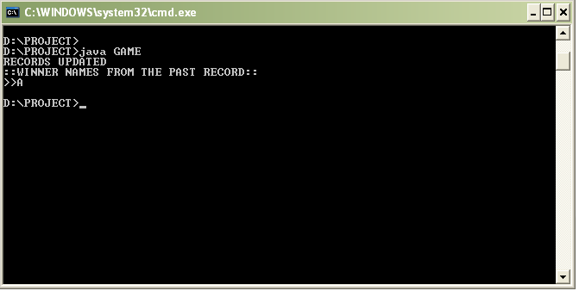
COMPILATION & WINNER DATA RECORDS

Slide 12
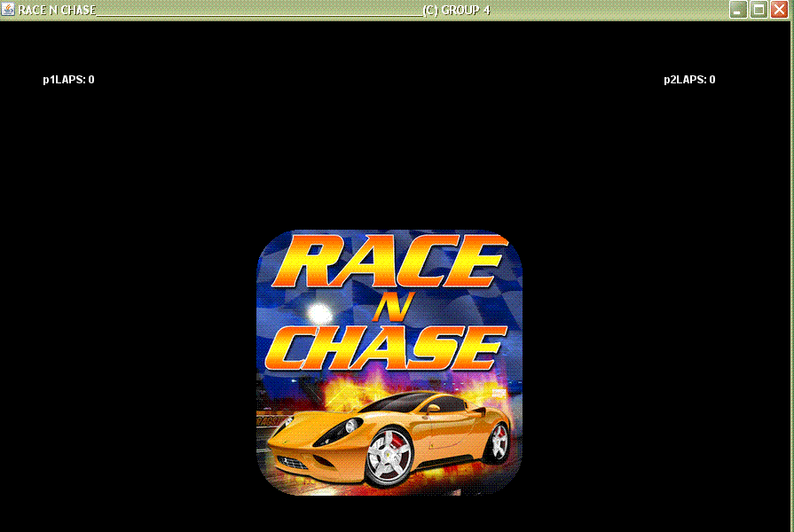
TITLE SCROLLING DOWN

Slide 13
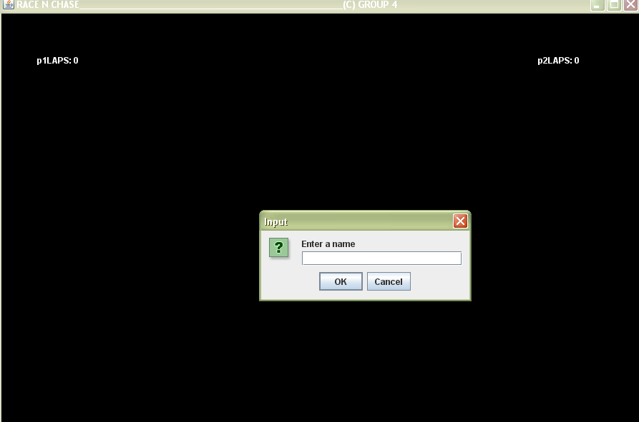
ENTER PLAYER NAME

Slide 14
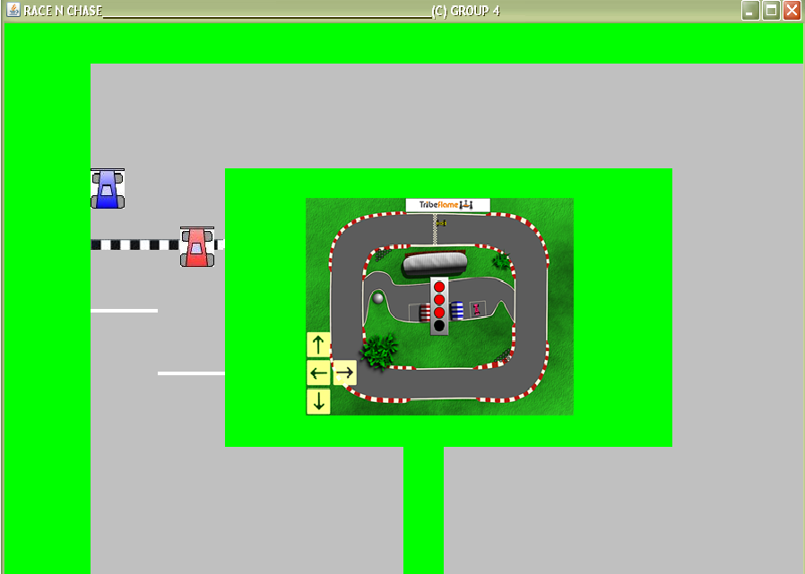
RACE BEGINS

Slide 15
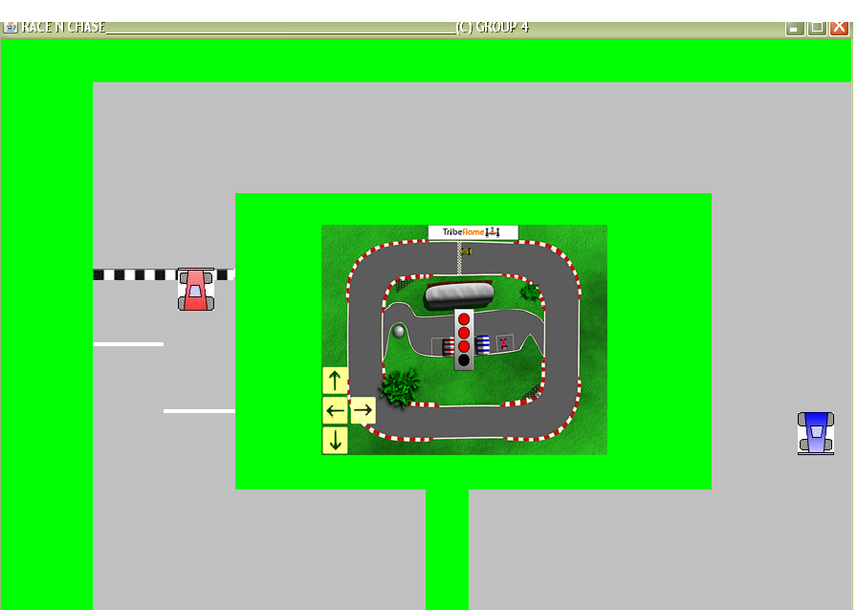
RACE IN PURSUIT

Slide 16
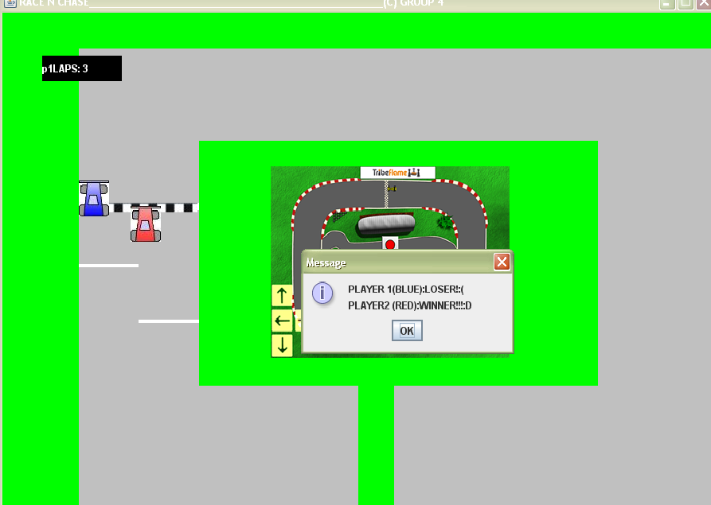
END OF RACE

Slide 17
Target audience
This racing project in its full grown state can be of huge attraction to the car racing fanatics .
The race tracks ,the complexities incorporated ,the high speed cars will create lasting effects on the racers.
The advantage of “PRO RACER” is that this software is equally good for the novice racers.
They can keep track of their performances and hence can improve their skills with time for the better

Slide 18
Future scope of improvement
The software “RACE N CHASE” is developed, as of now, for a friendly set of users.
The consistency, stability and tensile strength are under pin point observation .
The gaming software possesses the potential to get commercial with some special features ,in vogue in the market, being added along with the existing ones.

Slide 19



<:Bibliography:>
Java books
a.schildt
b.balaguruswamy
1.Project papers on java
2.Games source code
3.Google scholar
Wikipedia.org
NFS source code blog

Slide 20
T
H
A
N
K
-
Y
O
U

